Slide 1

DriverPass System Analysis
Joseph Farrish
Notes:
[No speaker notes required for this slide.]

Slide 2

System Requirements
Non-Functional Requirements.
Cloud based platform that serves a custom Front End, Provides secure interactions between customers.
Provides the client full access to the system from anywhere for on demand administration.
Functional Requirements
System support for Customer registration, purchasing and scheduling of lessons.
Provides logging of system activity to admins
Notes:
The Driver pass System can be split into two types of requirements Non-Functional Requirements and Functional Requirements. For Non-Functional Requirements DriverPass requires a cloud-based solution that can serve their services to customers while providing the necessary administration capabilities from anywhere an internet connection is available. The Functional Requirements cover the needs of the DriverPass customer so they can purchase, learn and schedule lessons. Each of these activities need to be logged to provide Administrators oversite and control of the system while generating revenue for DriverPass.

Slide 3
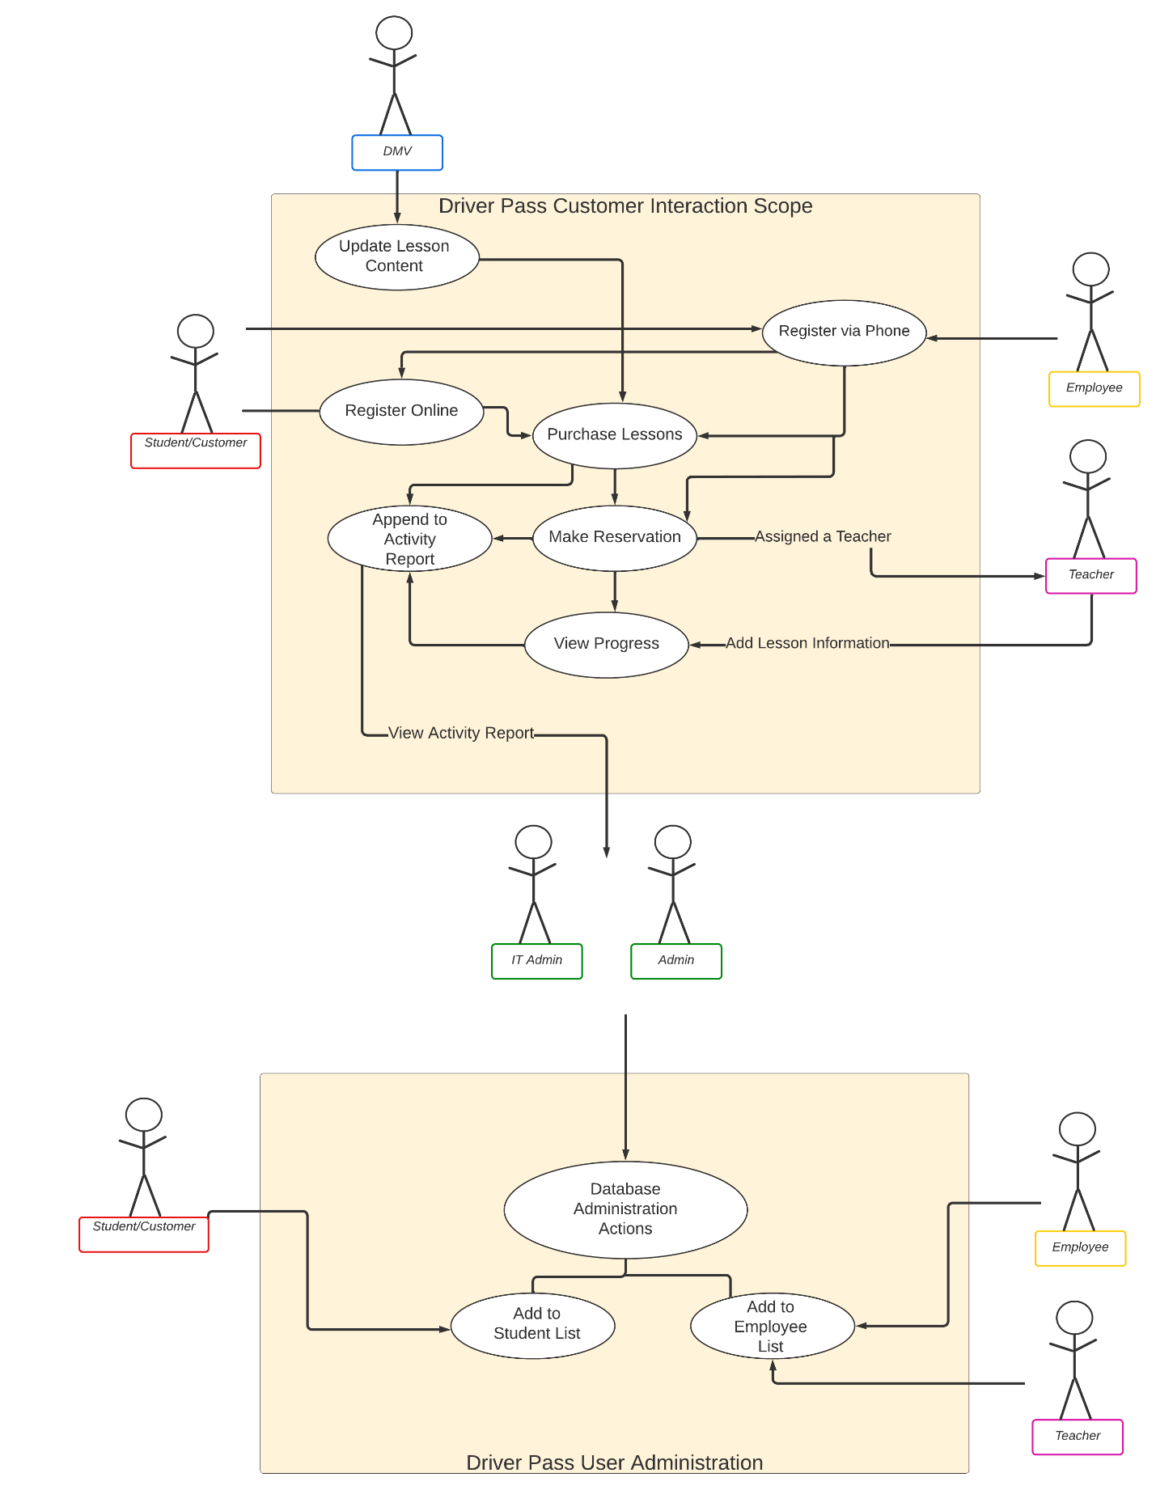
Use Case Diagram
Notes:
To fulfill the requirements Driver Pass can be split into two separate systems the Customer Interaction Scope and User Administration. Both systems feed logged interactions to the Admins. The customer Scope covers all interactions either online or via Phone call with an Employee. This activity feeds into an Activity report use case which feeds activity via a logs to the Admins. The Driver Pass User Administration block illustrates that all user information will be stored in a database and thus Admins will be able to freeze, disabled or activate Users via this block. The intent of this diagram was to efficiently illustrate the overall interactions that will take place in the system.

Slide 4
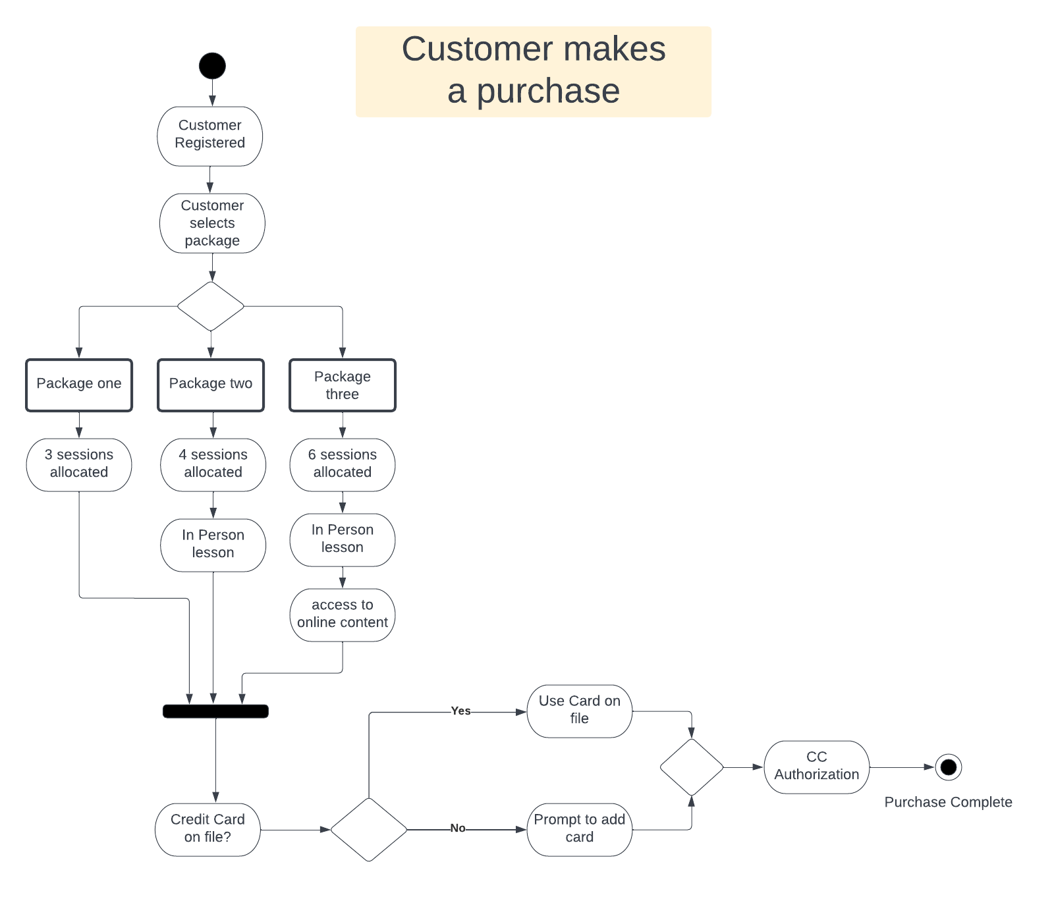
Activity Diagram
[Insert one of your activity diagrams here.]
Notes:
While each use case covers the responsibilities of the Systems designer these can be broken down into step-by step processes that will need to be supported. These are covered in Activity Diagrams in the above example illustrates a high-level overview of the Customer purchasing use case. The Activity Diagram is just one tool that is apart of the Analysis phase of the Systems development life cycle. The use of Activity Diagrams allows Systems Analysts to deliver completeness in the designs delivered to customers and developers who will ultimately construct the system.

Slide 5
Security
Use of a popular Cloudbased solution such as Azure, Amazon Cloud, Google Cloud, or IBM Cloud.
Use of a premade Learning Management System called PupilFirst
Use of WebApp Service Called Heroku
These cloud-based solutions allow for full security using top of the line measures that additionally allow DriverPass to scale.
Notes:
When considering Hardware and Security much of this responsibilities is being off loaded to the cloud-based provider. Use of WebApp services allows DriverPass to control what customers see and in turn limit what information is compromised. Using Services that are apart of LMS system called PupilFirst provide Driver Pass a secure platform to customize and build upon while also ensuring the security of its customers and employees.

Slide 6
System Limitations
System will require a significant amount of customization
System is premade requires the team to gain expertise on a pre-existing code base.
Requires knowledge of Ruby on Rails, React, and other systems that require specialization in these languages.
Notes:
Using a premade LMS comes with concerns the first is customization which will be needed to set DriverPass apart and give the client discerning qualities. This can be a challenge on when using a premade system. Additionally, it will require a team of experts become knowledgeable on a pre-existing code base, something that comes with its own challenges. Further Ruby on Rails while popular is not always the number one go to language for many web developers. These are fairly small limitations but require consideration non the less.

